Slide 1
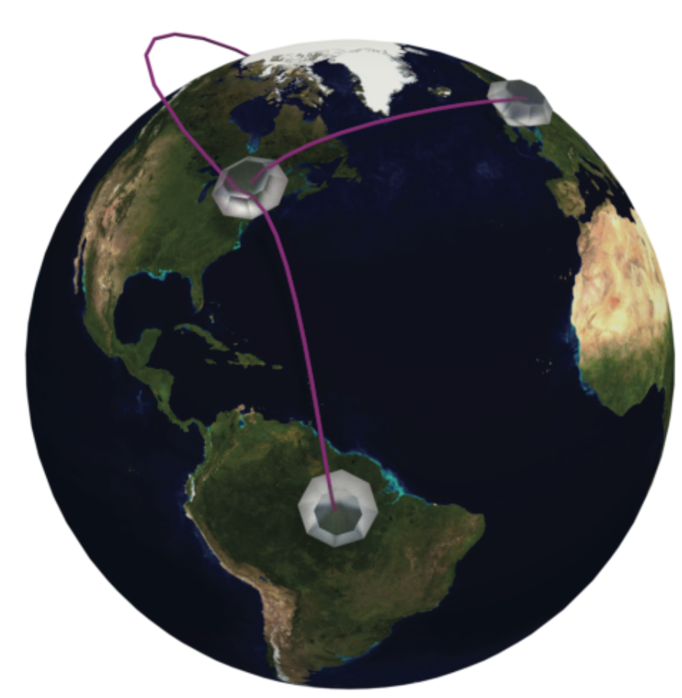
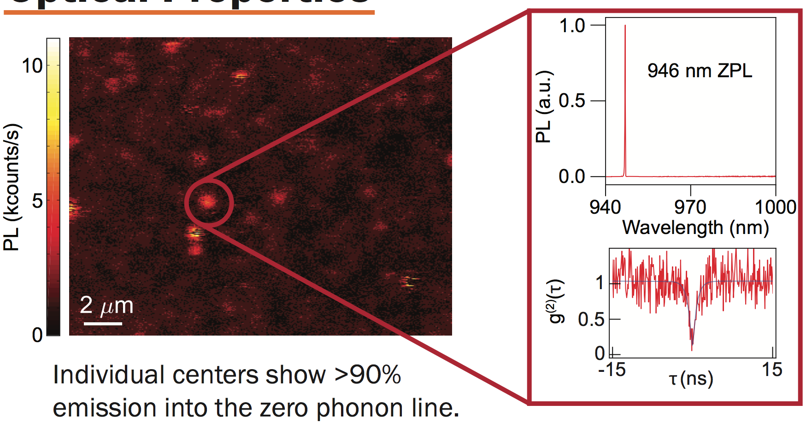
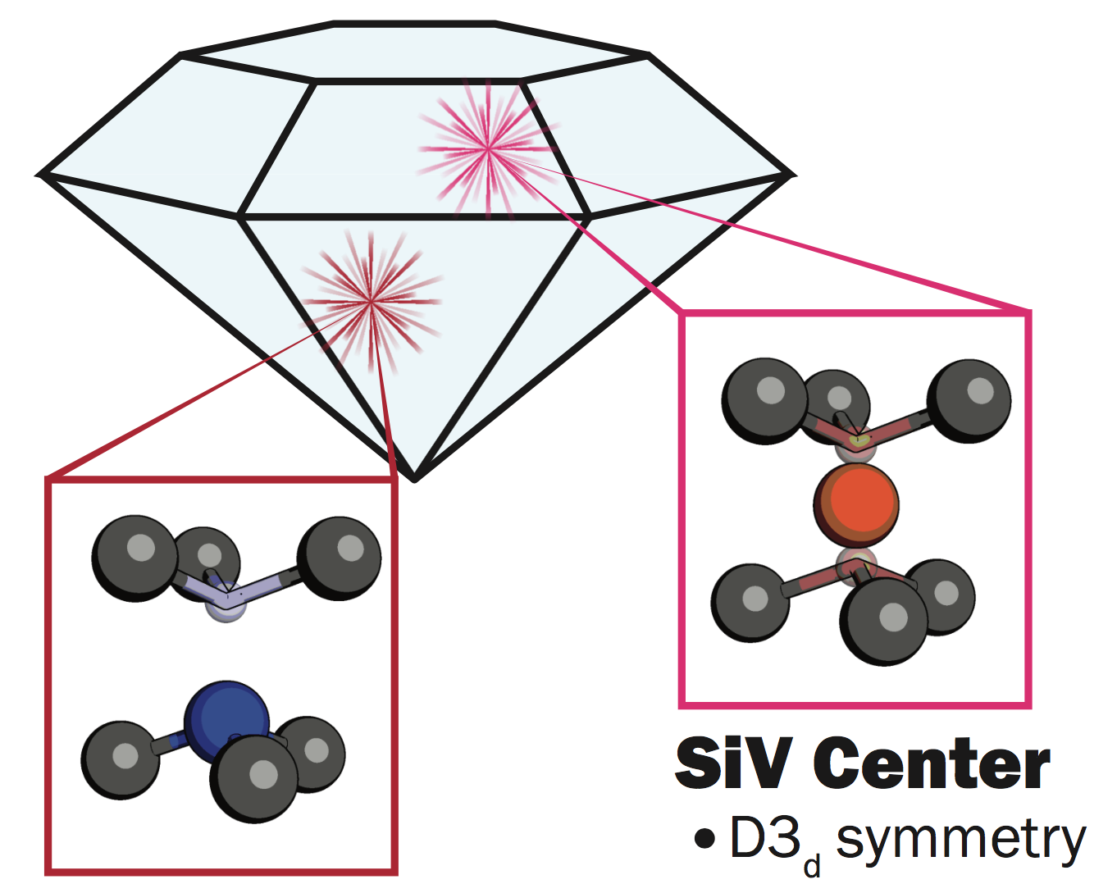
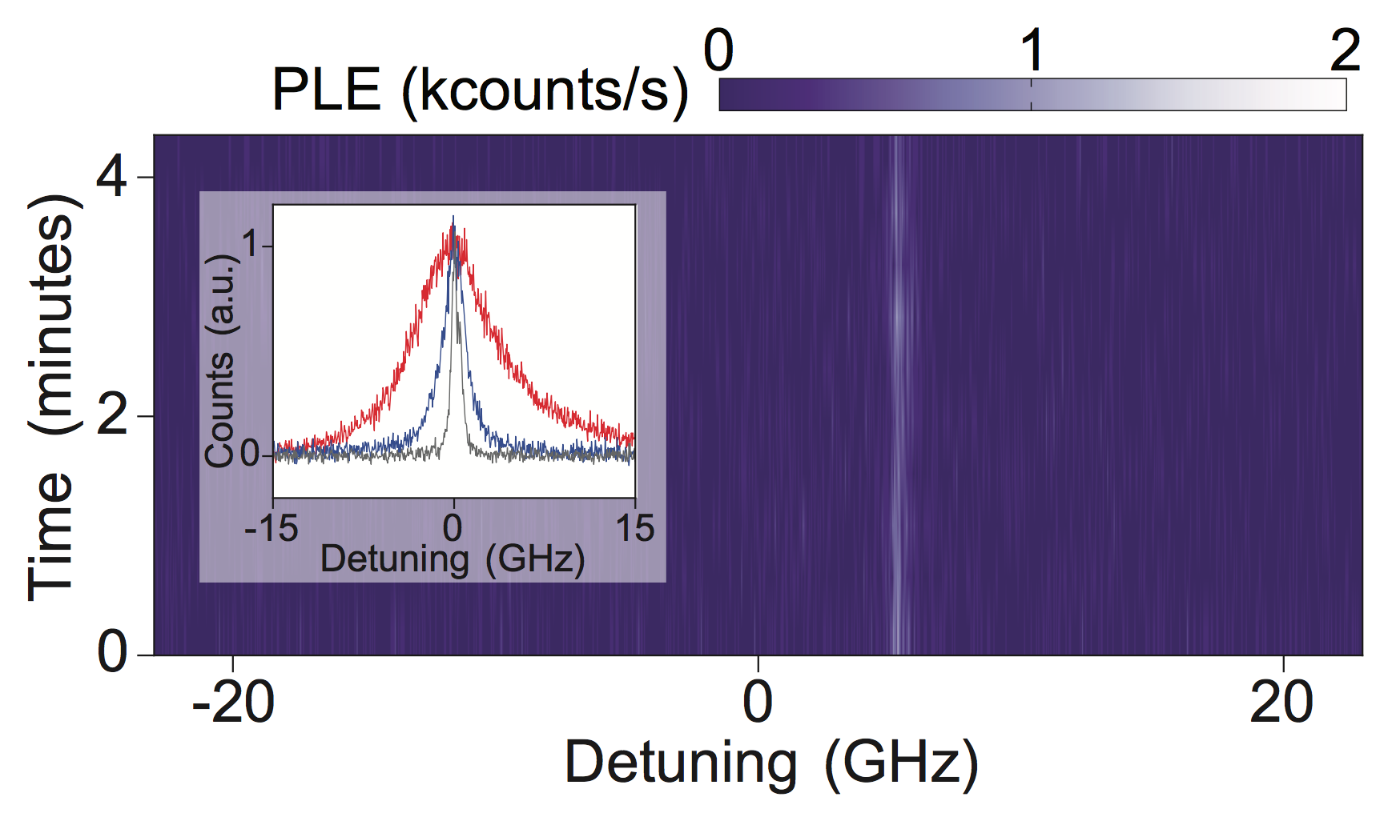
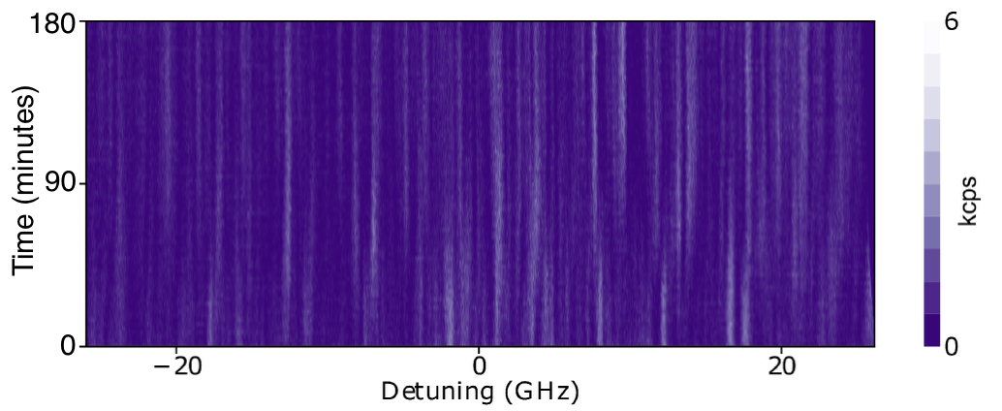
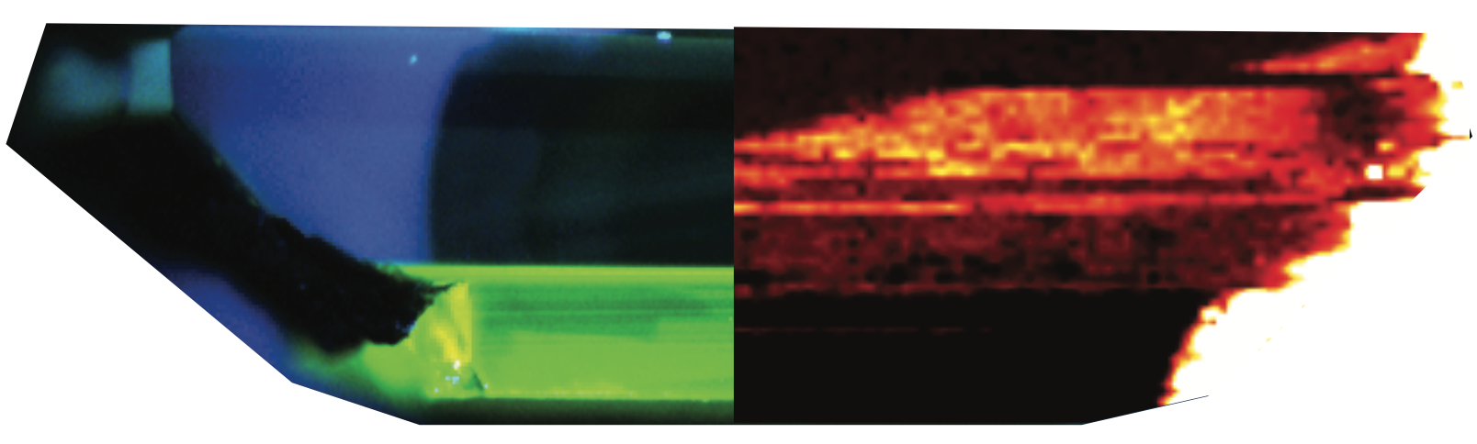
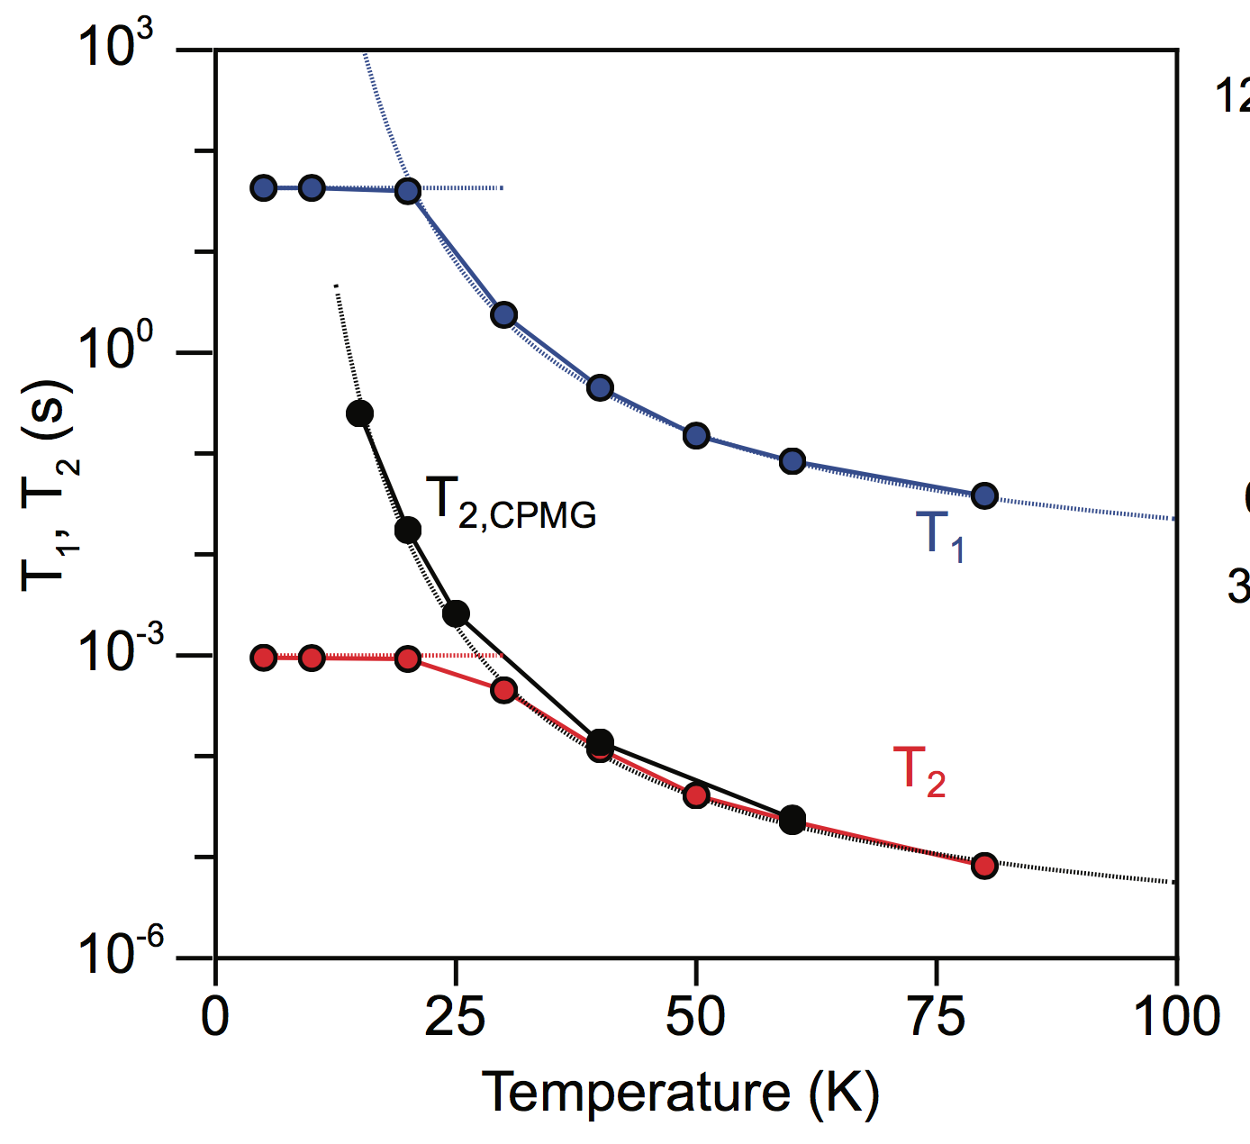
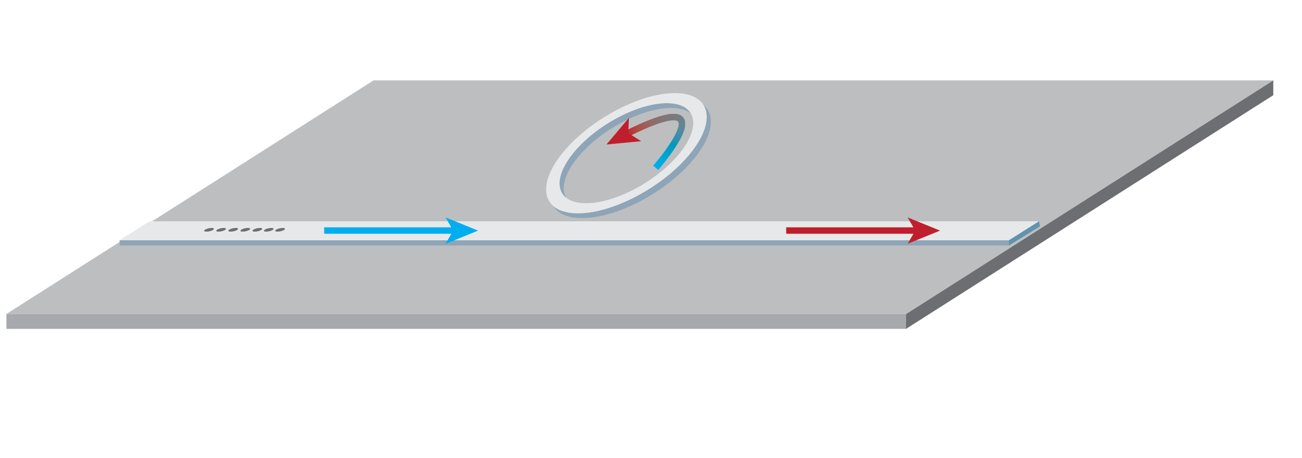




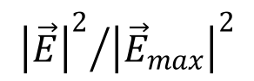
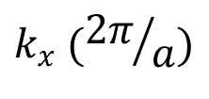
Nanophotonics for telecom quantum networks based on neutral silicon vacancy centers in diamond
Ding Huang, Alex Abulnaga, Sacha Welinski, Brendon C. Rose, Zi-Huai Zhang, Paul Stevenson, Nathalie P. de Leon
Department of Electrical Engineering, Princeton University
Requirements for quantum networks:
SiV⁰ is an excellent single photon source:
Photonic crystal cavity design
air
diamond
Long lived quantum memory
Efficient spin-photon interface
Identical photons
Telecom wavelength
Frequency (THz)
Q ~ 10⁴
$$k_{x} ({2π}/a)$$
Prior work on color centers in diamond:
Intensity (a.u.)
Near-transform-limited linewidth, low saturation power
Ensemble PLE shows all centers have narrow lines over hours
972.5
975
Quality factor
NV⁻ centers have long electron spin coherence, poor optical properties
SiV⁻ centers have better optical properties, poor spin coherence
Wavelength (nm)
$${{\left|\vec{E}\right|}^{2}}/{{\left|{\vec{E}}_{max}\right|}^{2}}$$
y = 0 nm
0
1
Number of mirror holes
200
Electric field intensity at SiV⁰ layer around 30% of peak value
z (nm)
0
-200
Neutral silicon vacancy centers
“Observation of an environmentally insensitive solid-state spin defect in diamond”
- Rose*, Huang*, et al, Science, 361, 60-63 (2018)
-400
0
400
y (nm)
Key idea—Fermi level engineering to stabilize neutral charge state of SiV, access new spin configuration
On-chip quantum frequency conversion scheme
Heterogeneously integrated GaAs-on-diamond photonic platform
3 dB attenuation distance in single mode fibers
Yb⁺ ions: 370 nm | < 50 m
NV⁻ center: 637 nm | 300 m
SiV⁻ center: 737 nm | 520 m
Rb atom: 780 nm | 750 m
SiV⁰ center & QDs: ~946 nm | 1.5 km
Telecom C-band: 1550 nm | 15 km
FWM-BS
UV PL
946 nm PL
946 nm optical emission allows for use of GaAs, a mature photonic platform
Evanescent coupling to SiV⁰ in diamond substrate
Fully integrated nanophotonic circuit using GaAs-on-diamond
SiV⁰
emission
Pump 2
SiV⁰ is a long lived quantum memory:
T₁ ~ 1 minute
T₂ ~ 1 second
Pump 1
1550 nm
GaAs nanobeam
SiV⁰
1550 nm
Group velocity (a.u.)
DMR-1420541
Diamond substrate
SiV⁰ Layer
FA9550-17-0158
EFRI
ACQUIRE 1640959
Wavelength (nm)
Collaboration with Jeff Thompson, Loren Pfeiffer
Experiments with other material platforms:
Srinivasan group, Nat. Photonics, 2016 (SiN); Radic group, PRL, 2010 (SiO₂)
YFA program: D18AP00047

